Slide 1
HealthyHens
WP0: Common cross sectional design
Husbandry
Feeding
Hygiene
other
Management
(Genetics)
WP1:
Parasite infestation
Laying
performance
WP2: Use of
free range
Mortality
WP3: Feather and
injurious pecking
Body weight
WP4: Other health problems
(e.g. keel bone and foot lesions)

Slide 2
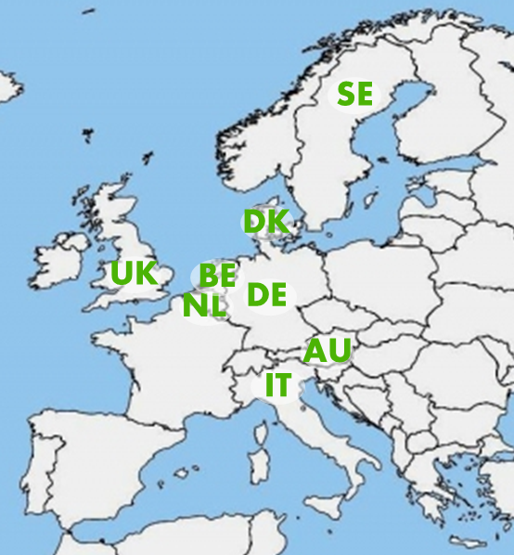
HealthyHens
Epidemiological approach with cross sectional design
110 organic layer flocks
  2 farm visits
  slaughterhouse visits for 55 flocks
8 project partners in 8 countries
  University of Kassel, Germany
  Fondazione CRPA Studi Ricerche, Italy
  Aarhus University, Denmark
  ADAS UK Ltd., United Kingdom
  Louis Bolk Institute, The Netherlands
  University of Veterinary Medicine Vienna, Austria
  Swedish university of Agricultural Sciences, Sweden
  Institute for Agricultural and Fisheries Research, Belgium

Slide 3
HealthyHens
Results so far:
Sample covers a wide range of production conditions
  e.g. covered verandas, single/multi tier, range rotation
Most outcomes show a good distribution
  Infection with A. galli and Heterakis: 61 % of flocks at the end of lay
  Feather pecking: 0 to 100 %
  (Pecking) wounds: 0 to 96 %
  Keel bone fractures: 0 to 88 % (mean 28 %)
  Keel bone deviations: 0 to 84 % (mean 31 %)
A few outcomes with very low prevalence
  Haematomas at keel bone
  worms other than A. galli and Heterakis (but worm infection in general follows A. galli and Heterakis infection pattern)

